Slide 1
Hidden Markov Models—Variants
Conditional Random Fields
1
1
1
1
…
1
2
2
2
2
2
…
2
…
…
…
…
K
K
K
K
…
K
x₁
x₂
x₃
x_{K}

Slide 2
Two learning scenarios
Estimation when the “right answer” is known
  Examples:
  GIVEN: a genomic region x = x₁…x_{1,000,000} where we have good (experimental) annotations of the CpG islands
  GIVEN: the casino player allows us to observe him one evening, as he changes dice and produces 10,000 rolls
Estimation when the “right answer” is unknown
  Examples:
  GIVEN: the porcupine genome; we don’t know how frequent are the CpG islands there, neither do we know their composition
  GIVEN: 10,000 rolls of the casino player, but we don’t see when he changes dice
QUESTION: Update the parameters θ of the model to maximize P(x|θ)

Slide 3
1. When the “true” parse is known
Given x = x₁…x_{N}
for which the true π = π₁…π_{N} is known,
Simply count up # of times each transition & emission is taken!
Define:
A_{kl} = # times k→l transition occurs in π
E_{k}(b) = # times state k in π emits b in x
We can show that the maximum likelihood parameters θ (maximize P(x|θ)) are:
A_{kl} E_{k}(b)
a_{kl} = ––––– e_{k}(b) = –––––––
Σ_{i} A_{ki} Σ_{c} E_{k}(c)

Slide 4
2. When the “true parse” is unknown
Baum-Welch Algorithm
Compute expected # of times each transition & is taken!
  Initialization:
  Pick the best-guess for model parameters
  (or arbitrary)
  Iteration:
    Forward
    Backward
    Calculate A_{kl}, E_{k}(b), given θ_{CURRENT}
    Calculate new model parameters θ_{NEW} : a_{kl}, e_{k}(b)
    Calculate new log-likelihood P(x | θ_{NEW})
  GUARANTEED TO BE HIGHER BY EXPECTATION-MAXIMIZATION
Until P(x | θ) does not change much

Slide 5

Variants of HMMs

Slide 6
Higher-order HMMs
How do we model “memory” larger than one time point?
P(π_{i+1} = l | π_{i} = k) a_{kl}
P(π_{i+1} = l | π_{i} = k, π_{i -1} = j) a_{jkl}
…
A second order HMM with K states is equivalent to a first order HMM with K² states
state HH
a_{HHT}
state HT
a_{HT}(prev = H)
a_{HT}(prev = T)
a_{HTH}
state H
state T
a_{THH}
a_{HTT}
a_{THT}
state TH
state TT
a_{TH}(prev = H)
a_{TH}(prev = T)
a_{TTH}

Slide 7
Modeling the Duration of States
1-p
Length distribution of region X:
E[l_{X}] = 1/(1-p)
Geometric distribution, with mean 1/(1-p)
This is a significant disadvantage of HMMs
Several solutions exist for modeling different length distributions
X
Y
p
q
1-q

Slide 8
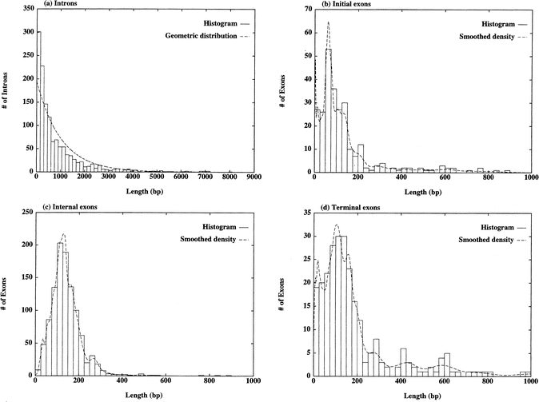
Example: exon lengths in genes
Notes:
Why the algorithm has to be generalized is because in a standard HMM the output in each step would be one base, leading to state durations of geometric length. If we look at empirical data, such as these plots, we see that the intron lengths seem to follow the geometric distribution fairly well, but for the exon that would be a pretty bad model. So in our state space the exons are generalized states, choosing a length from a general distribution and outputting the entire exon in one step, while the intron and intergene states still output one base at a time and follow the geometric distribution.

Slide 9
Solution 1: Chain several states
p
1-p
X
X
X
Y
q
1-q
Disadvantage: Still very inflexible
l_{X} = C + geometric with mean 1/(1-p)

Slide 10
Solution 2: Negative binomial distribution
p
p
p
1 – p
1 – p
1 – p
X⁽¹⁾
X⁽²⁾
X^{(n)}
Y
……
Duration in X: m turns, where
  During first m – 1 turns, exactly n – 1 arrows to next state are followed
  During m^{th} turn, an arrow to next state is followed
m – 1 m – 1
P(l_{X} = m) = n – 1 (1 – p)^{n-1+1}p^{(m-1)-(n-1)} = n – 1 (1 – p)^{n}p^{m-n}

Slide 11
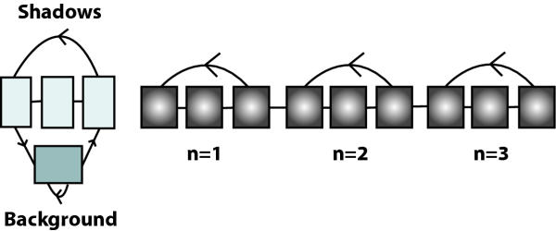
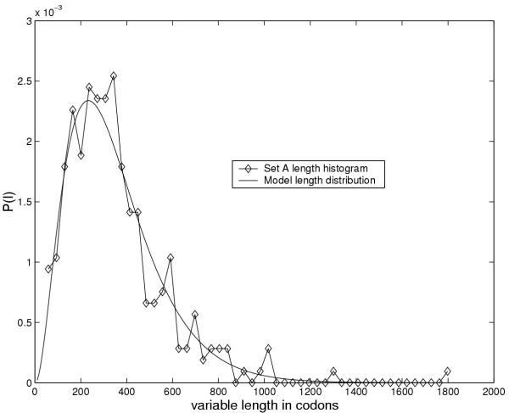
Example: genes in prokaryotes
EasyGene:
Prokaryotic
gene-finder
  Larsen TS, Krogh A
Negative binomial with n = 3

Slide 12
Solution 3: Duration modeling
Upon entering a state:
Choose duration d, according to probability distribution
Generate d letters according to emission probs
Take a transition to next state according to transition probs
Disadvantage: Increase in complexity of Viterbi:
Time: O(D)
Space: O(1)
where D = maximum duration of state
F
d<D_{f}
x_{i}…x_{i+d-1}
P_{f}
Warning, Rabiner’s tutorial claims O(D²) & O(D) increases

Slide 13
Viterbi with duration modeling
emissions
emissions
F
L
d<D_{f}
P_{f}
d<D_{l}
P_{l}
transitions
x_{i}…x_{i + d – 1}
x_{j}…x_{j + d – 1}
Precompute cumulative values
Recall original iteration:
Vl(i) = max_{k} V_{k}(i – 1) a_{kl} × e_{l}(x_{i})
New iteration:
V_{l}(i) = max_{k} max_{d=1…Dl} V_{k}(i – d) × P_{l}(d) × a_{kl} × Π_{j=i-d+1…i}e_{l}(x_{j})

Slide 14
Conditional Random Fields
A brief description of a relatively new kind of graphical model

Slide 15
Let’s look at an HMM again
1
1
1
1
…
1
2
2
2
2
2
…
2
…
…
…
…
K
K
K
K
…
K
x₁
x₂
x₃
x_{N}
Why are HMMs convenient to use?
  Because we can do dynamic programming with them!
    “Best” state sequence for 1…i interacts with “best” sequence for i+1…N using K² arrows
V_{l}(i+1) = e_{l}(i+1) max_{k} V_{k}(i) a_{kl}
= max_{k}( V_{k}(i) + [ e(l, i+1) + a(k, l) ] ) (where e(.,.) and a(.,.) are logs)
    Total likelihood of all state sequences for 1…i+1 can be calculated from total likelihood for 1…i by only summing up K² arrows

Slide 16
Let’s look at an HMM again
1
1
1
1
…
1
2
2
2
2
2
…
2
…
…
…
…
K
K
K
K
…
K
x₁
x₂
x₃
x_{N}
Some shortcomings of HMMs
  Can’t model state duration
    Solution: explicit duration models (Semi-Markov HMMs)
  Unfortunately, state π_{i} cannot “look” at any letter other than x_{i}!
    Strong independence assumption: P(π_{i} | x₁…x_{i-1}, π₁…π_{i-1}) = P(π_{i} | π_{i-1})

Slide 17
Let’s look at an HMM again
1
1
1
1
…
1
2
2
2
2
2
…
2
…
…
…
…
K
K
K
K
…
K
x₁
x₂
x₃
x_{N}
Another way to put this, features used in objective function P(x, π):
  a_{kl}, e_{k}(b), where b ∈ Σ
  At position i: all K² a_{kl} features, and all K e_{l}(x_{i}) features play a role
  OK forget probabilistic interpretation for a moment
  “Given that prev. state is k, current state is l, how much is current score?”
    V_{l}(i) = V_{k}(i – 1) + (a(k, l) + e(l, i)) = V_{k}(i – 1) + g(k, l, x_{i})
    Let’s generalize g!!! V_{k}(i – 1) + g(k, l, x, i)

Slide 18
“Features” that depend on many pos. in x
π_{i-1}
π_{i}
x₁
x₂
x₃
x₄
x₅
x₆
x₇
x₈
x₉
x₁₀
What do we put in g(k, l, x, i)?
  The “higher” g(k, l, x, i), the more we like going from k to l at position i
Richer models using this additional power
  Examples
    Casino player looks at previous 100 pos’ns; if > 50 6s, he likes to go to Fair
g(Loaded, Fair, x, i) += 1[x_{i-100}, …, x_{i-1} has > 50 6s] × w_{DON’T_GET_CAUGHT}
    Genes are close to CpG islands; for any state k,
g(k, exon, x, i) += 1[x_{i-1000}, …, x_{i+1000} has > 1/16 CpG] × w_{CG_RICH_REGION}

Slide 19
“Features” that depend on many pos. in x
x₁
x₂
x₃
x₄
x₅
x₆
x₇
x₈
x₉
x₁₀
Conditional Random Fields—Features
Define a set of features that you think are important
  All features should be functions of current state, previous state, x, and position i
  Example:
    Old features: transition k→l, emission b from state k
    Plus new features: prev 100 letters have 50 6s
  Number the features 1…n: f₁(k, l, x, i), …, f_{n}(k, l, x, i)
    features are indicator true/false variables
  Find appropriate weights w₁,…, w_{n} for when each feature is true
    weights are the parameters of the model
Let’s assume for now each feature has a weight w_{j}
  Then, g(k, l, x, i) = Σ_{j=1…n} f_{j}(k, l, x, i) × w_{j}

Slide 20
“Features” that depend on many pos. in x
x₁
x₂
x₃
x₄
x₅
x₆
x₇
x₈
x₉
x₁₀
Define
V_{k}(i): Optimal score of “parsing” x₁…x_{i} and ending in state k
Then, assuming V_{k}(i) is optimal for every k at position i, it follows that
V_{l}(i+1) = max_{k} [V_{k}(i) + g(k, l, x, i+1)]
Why?
Even though at pos’n i+1 we “look” at arbitrary positions in x, we are only “affected” by the choice of ending state k
Therefore, Viterbi algorithm again finds optimal (highest scoring) parse for x₁…x_{N}

Slide 21
“Features” that depend on many pos. in x
π₁
π₂
π₃
π₄
π₅
π₆
…
HMM
x₁
x₂
x₃
x₄
x₅
x₆
π₁
π₂
π₃
π₄
π₅
π₆
…
CRF
x₁
x₂
x₃
x₄
x₅
x₆
Score of a parse depends on all of x at each position
Can still do Viterbi because state π_{i} only “looks” at prev. state π_{i-1} and the constant sequence x

Slide 22
How many parameters are there, in general?
Arbitrarily many parameters!
  For example, let f_{j}(k, l, x, i) depend on x_{i-5}, x_{i-4}, …, x_{i+5}
    Then, we would have up to K × | Σ |¹¹ parameters!
  Advantage: powerful, expressive model
    Example: “if there are more than 50 6’s in the last 100 rolls, but in the surrounding 18 rolls there are at most 3 6’s, this is evidence we are in Fair state”
      Interpretation: casino player is afraid to be caught, so switches to Fair when he sees too many 6’s
    Example: “if there are any CG-rich regions in the vicinity (window of 2000 pos) then favor predicting lots of genes in this region”
  Question: how do we train these parameters?

Slide 23
Conditional Training
Hidden Markov Model training:
  Given training sequence x, “true” parse π
  Maximize P(x, π)
Disadvantage:
  P(x, π) = P(π | x) P(x)
Quantity we care about
so as to get a good parse
Quantity we don’t care so much
about because x is always given

Slide 24
Conditional Training
P(x, π) = P(π | x) P(x)
P(π | x) = P(x, π) / P(x)
Recall
F(j, x, π) = # times feature f_{j} occurs in (x, π)
= Σ_{i=1…N} f_{j}(k, l, x, i) ; count f_{j} in x, π
In HMMs, let’s denote by w_{j} the weight of j^{th} feature: w_{j} = log(a_{kl}) or log(e_{k}(b))
Then,
HMM: P(x, π) = exp[Σ_{j=1…n} w_{j} × F(j, x, π)]
CRF: Score(x, π) = exp[Σ_{j=1…n} w_{j} × F(j, x, π)]

Slide 25
Conditional Training
In HMMs,
P(π | x) = P(x, π) / P(x)
P(x, π) = exp[Σ_{j=1…n} w_{j}×F(j, x, π)]
P(x) = Σ_{π} exp[Σ_{j=1…n} w_{j}×F(j, x, π)] =: Z
Then, in CRF we can do the same to normalize Score(x, π) into a prob.
P_{CRF}(π | x) = exp[Σ_{j=1…n} w_{j}×F(j, x, π)] / Z
QUESTION: Why is this a probability???

Slide 26
Conditional Training
We need to be given a set of sequences x and “true” parses π
Calculate Z by a sum-of-paths algorithm similar to HMM
  We can then easily calculate P(π | x)
Calculate partial derivative of P(π | x) w.r.t. each parameter w_{j}
  (not covered—akin to forward/backward)
  Update each parameter with gradient descent!
Continue until convergence to optimal set of weights
P(π | x) = exp[Σ_{j=1…n} w_{j}×F(j, x, π)] / Z is convex!!!

Slide 27
Conditional Random Fields—Summary
Ability to incorporate complicated non-local feature sets
  Do away with some independence assumptions of HMMs
  Parsing is still equally efficient
Conditional training
  Train parameters that are best for parsing, not modeling
  Need labeled examples—sequences x and “true” parses π
    (Can train on unlabeled sequences, however it is unreasonable to train too many parameters this way)
  Training is significantly slower—many iterations of forward/backward

